Slide 1

Share Market
Name- pURnamita Swain
dipti rani bindhani
Sanjana pradhan

Slide 2
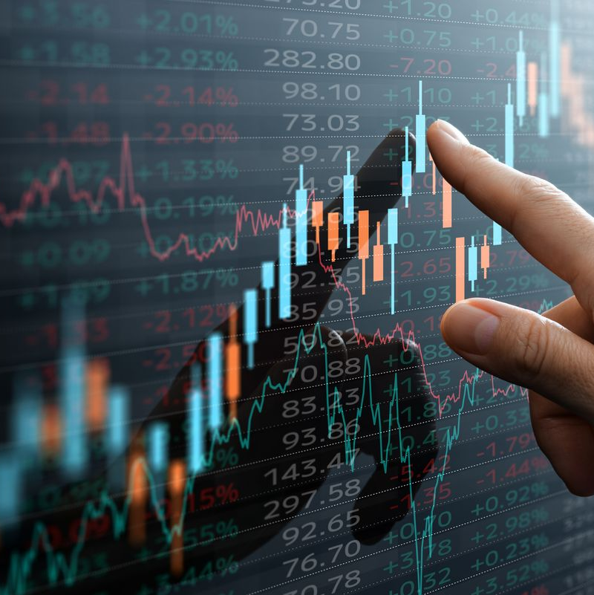
Share Market Prediction
Share market prediction forecasts stock prices and market trends. It uses analytical techniques like fundamental analysis and machine learning.
Prediction involves studying past data, economic indicators, and market trends. Investors use historical price movements and financial reports.

Slide 3
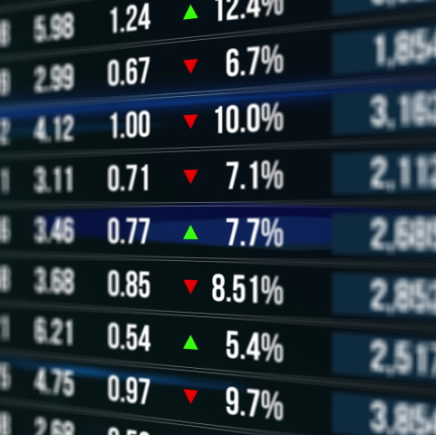
Importance of Stock Prediction
1. Maximize Returns 2. Risk Management

Slide 4

What is a Stock Market?
Capital Raising
Companies issue stocks to raise funds for expansion.
Investment
Investors can buy stocks to earn returns.
Liquidity
Investors can easily buy or sell stocks.

Slide 5
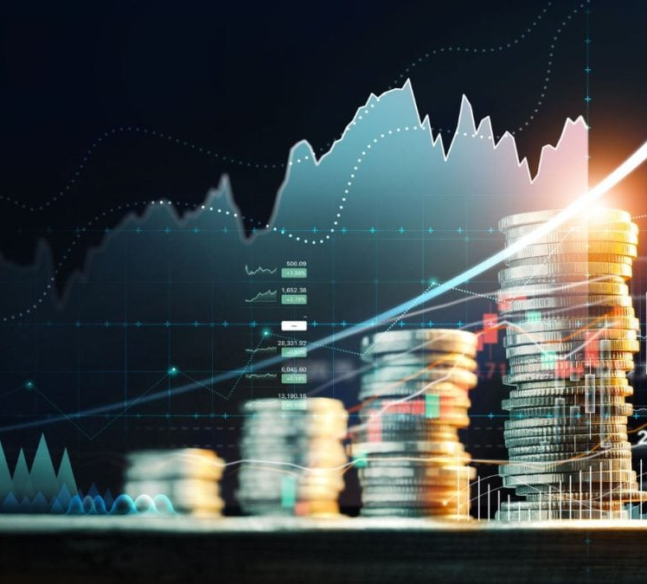



Key Participants in the Stock Market
Investors
Traders
Institutions

Slide 6
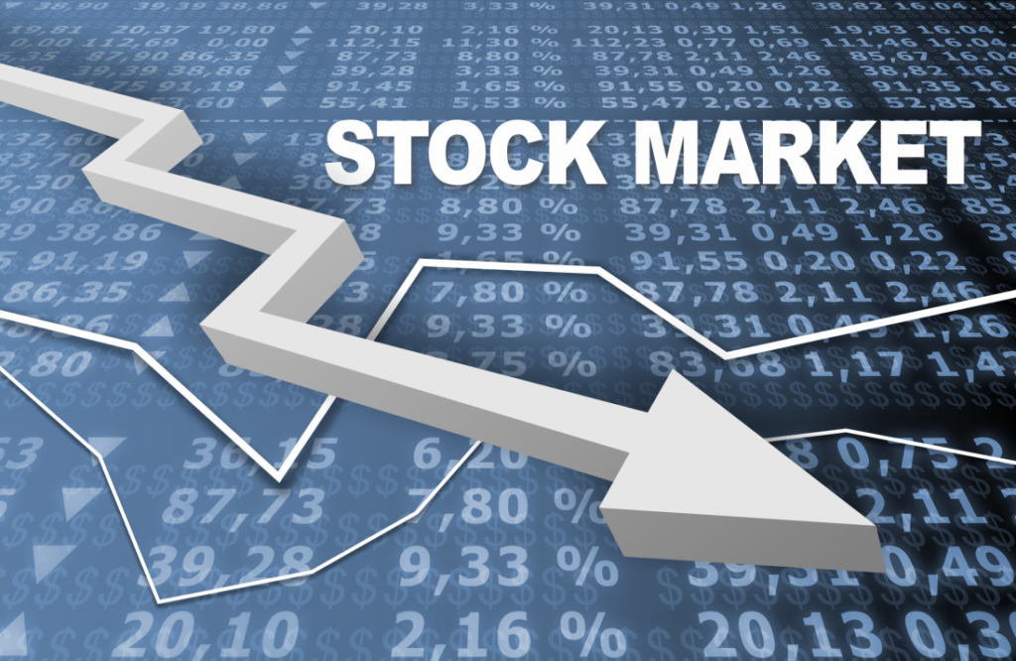
Types of Stock Markets
1.Primary Market
2.Secondary Market

Slide 7

Primary Market
The primary stock market is where companies issue new stocks to investors for the first time through an Initial Public Offering (IPO) or other offerings. It helps businesses raise capital directly from investors.

Slide 8

Secondary Market
Investors trade existing shares on the secondary market. It's where stock changes hands after its initial offering, with prices driven by supply and demand.

Slide 9
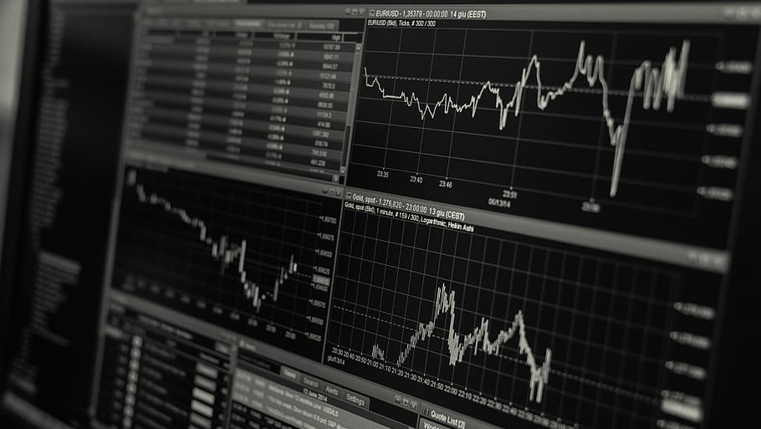
Hypothesis
What do you believe to be true about your subject?
What are you going to try to convince your audience of?
Key Share Market Prediction Method

Slide 10
Quantitative Analysis
This involves the use of mathematical and statistical models to identify trading opportunities.
It often involves the use of computers to sift through large amounts of data to find trends.

Slide 11
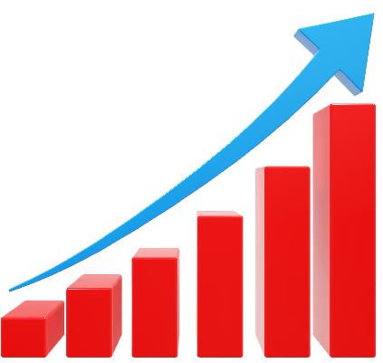
Fundamental Analysis
This method involves evaluating a company's intrinsic value by examining financial statements, economic indicators, and industry trends.
It focuses on factors like revenue, earnings, and management quality to determine if a stock is undervalued or overvalued.

Slide 12

Technical Analysis
This approach analyzes historical price and volume data to identify patterns and trends.
Technical analysts use charts and indicators to predict future price movements, often focusing on short-term trading opportunities.

Slide 13

Machine Learning
With the increase of computational power, machine learning algorithms are increasingly used.
These algorithms can recognize complex patterns in large datasets, and attempt to predict future market movements.
Algorithms like Long Short-Term Memory (LSTM) are used to analyze time series data.

Slide 14

Market Overview

Slide 15

Historical Trends
Examining past market performances reveals patterns and cycles that can inform future predictions. Analysts study significant events that have shaped market behavior, including economic downturns, booms, and recovery phases.

Slide 16

Current Conditions
An analysis of the current market environment, including key indices, trading volumes, and economic indicators, Understanding present conditions helps in comparing against historical data to forecast future movements.

Slide 17

Market Participants
Identifying and understanding the roles of various market participants, such as institutional investors, retail investors, market makers, and hedge funds. Each player has different strategies and influences on market dynamics.

Slide 18

Influencing Factors

Slide 19

Economic Indicators
Key economic indicators such as GDP growth, unemployment rates, and inflation significantly influence stock market predictions. Analysts look at these indicators to gauge the health of the economy, which in turn affects investor sentiment and stock prices.

Slide 20

Geopolitical Events
Events such as elections, international trade tensions, and conflicts can dramatically affect market conditions. Investors react to news from around the globe, which can lead to sudden shifts in market behavior, impacting stock valuations.

Slide 21

Market Trends
Market trends drive stock prices: uptrends boost them, downtrends lower them, based on investor sentiment and supply/demand.

Slide 22

Risk Assessment

Slide 23

Volatility Analysis
Volatility is a measure of how much the price of an asset varies over time. Assessing volatility helps investors understand risk and make decisions about buying or selling in uncertain conditions.

Slide 24

Portfolio Diversification
Portfolio diversification is the strategy of allocating investments among different asset classes to optimize risk and return.
This approach helps investors protect against losses in specific areas by balancing their portfolio with gains from other sectors, resulting in more consistent overall performance.

Slide 25
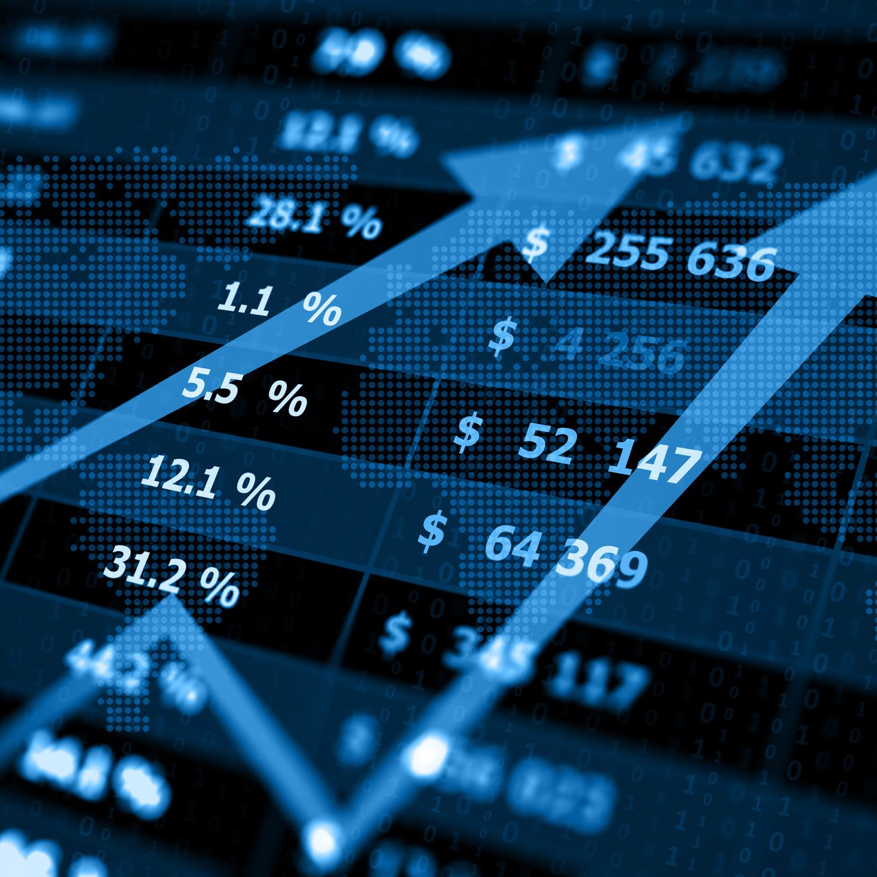
Long-Term Forecasts
Long-term forecasts are essential for strategic investment planning. Analysts use historical data, economic indicators, and market trends to predict potential future movements and guide investment strategies over an extended period.

Slide 26
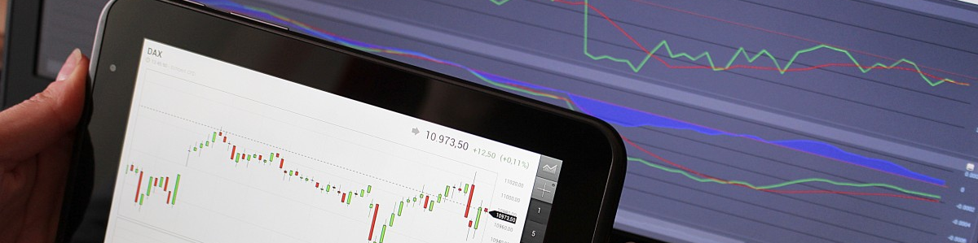
Project Title :
Share Market Prediction
Sub Title : Multi Algorithmic Stock Predictor

Slide 27
Introduction
What is the project?
A stock price prediction system using multiple machine learning algorithms.
Purpose:
Help traders & investors make data-driven decisions.
Combine technical analysis, news sentiment, and AI predictions.

Slide 28

Problem Statement
Challenges in Stock Trading: .Highly volatile and unpredictable market. .Traditional analysis methods are often subjective and slow. .Need for real-time data-driven insights.
Solution: A machine learning-based stock predictor that integrates multiple models & data sources.

Slide 29

Features & Capabilities
Ensemble predictions from multiple ML models.
Live stock data integration.
News sentiment analysis to gauge market trends.
Risk assessment & confidence scoring.

Slide 30

Why Machine Learning Instead of Traditional Methods?
Captures non-linear patterns in stock prices.
Learns from historical data and adapts to new trends.
Analyzes multiple factors. (price, volume, news, indicators)
Provides confidence scores & risk assessments.

Slide 31
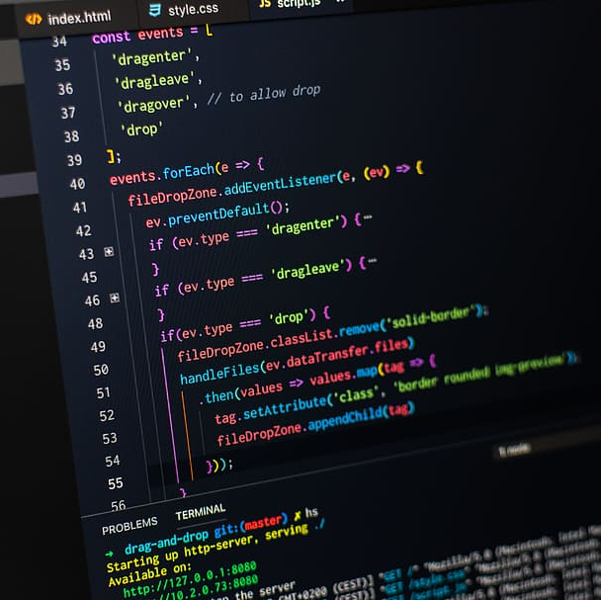
Technology Stack & Architecture
Frontend: Built with Streamlit for an interactive web interface with real-time stock visualizations.
Backend: Uses Python
Data Fetching:
* Stock data from Yahoo Finance. (yfinance)
* News sentiment from NewsAPI, NLTK, TextBlob.
Framework: Streamlit enables seamless integration of data, models, and visualizations.

Slide 32

Algorithms Used
Linear Regression
Random Forest
XGBoost
LSTM
SVR
ARIMA
Prophet
GARCH
Sentiment Analysis (TextBlob, NLTK)

Slide 33

How It Works? . User selects a stock . Live stock data is fetched . ML models process the data . Sentiment analysis evaluates market news . Predictions & technical indicators are displayed

Slide 34
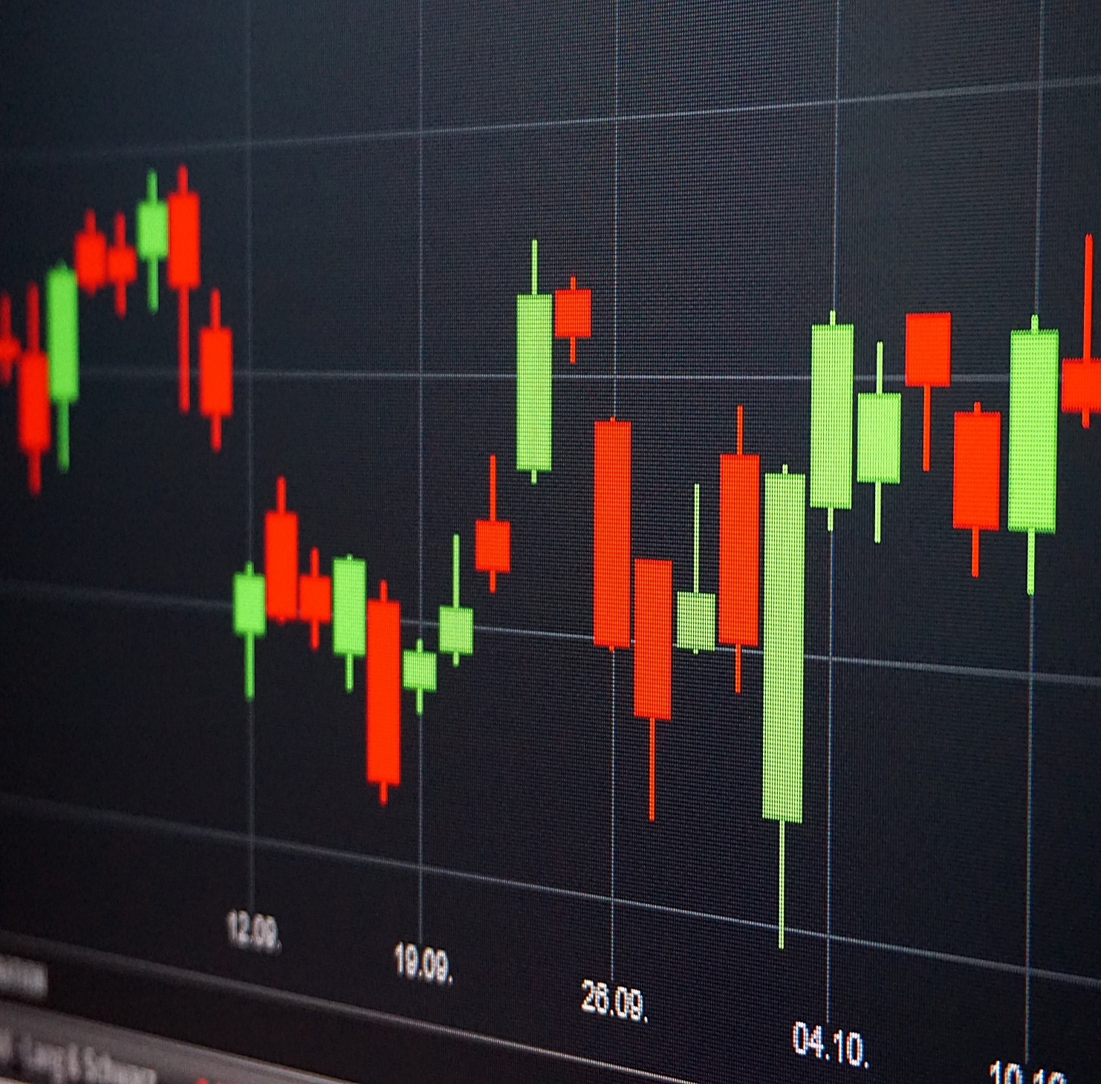
Trading Signals & Risk Assessment
Strong Buy: >10% predicted price increase.
Moderate Buy: 3-10% increase.
Hold: <1% change.
Sell: Negative prediction.
Confidence Scores: High (>0.8), Medium (0.6-0.8), Low (<0.6)

Slide 35

Live Demo Screenshots

Slide 36
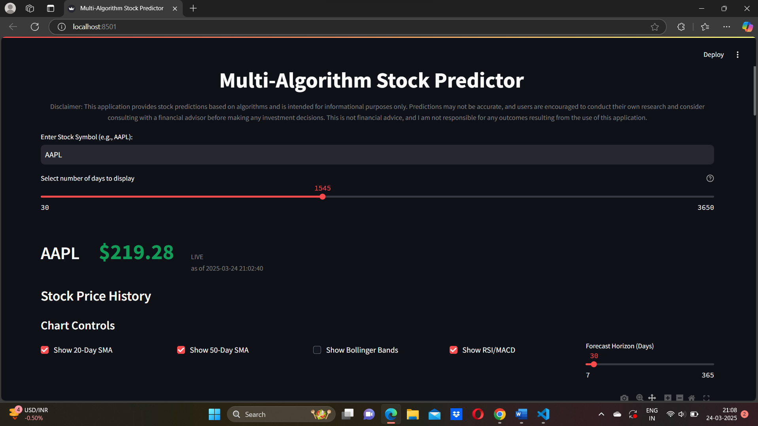
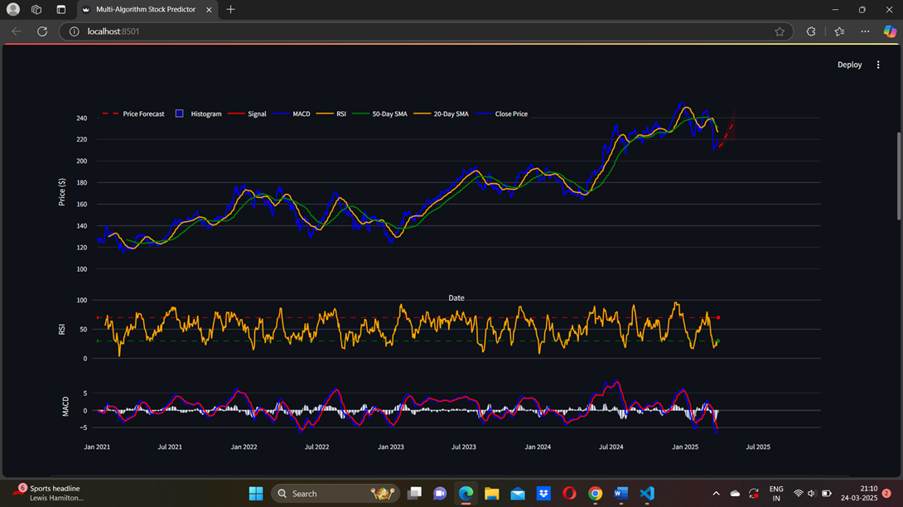

Slide 37
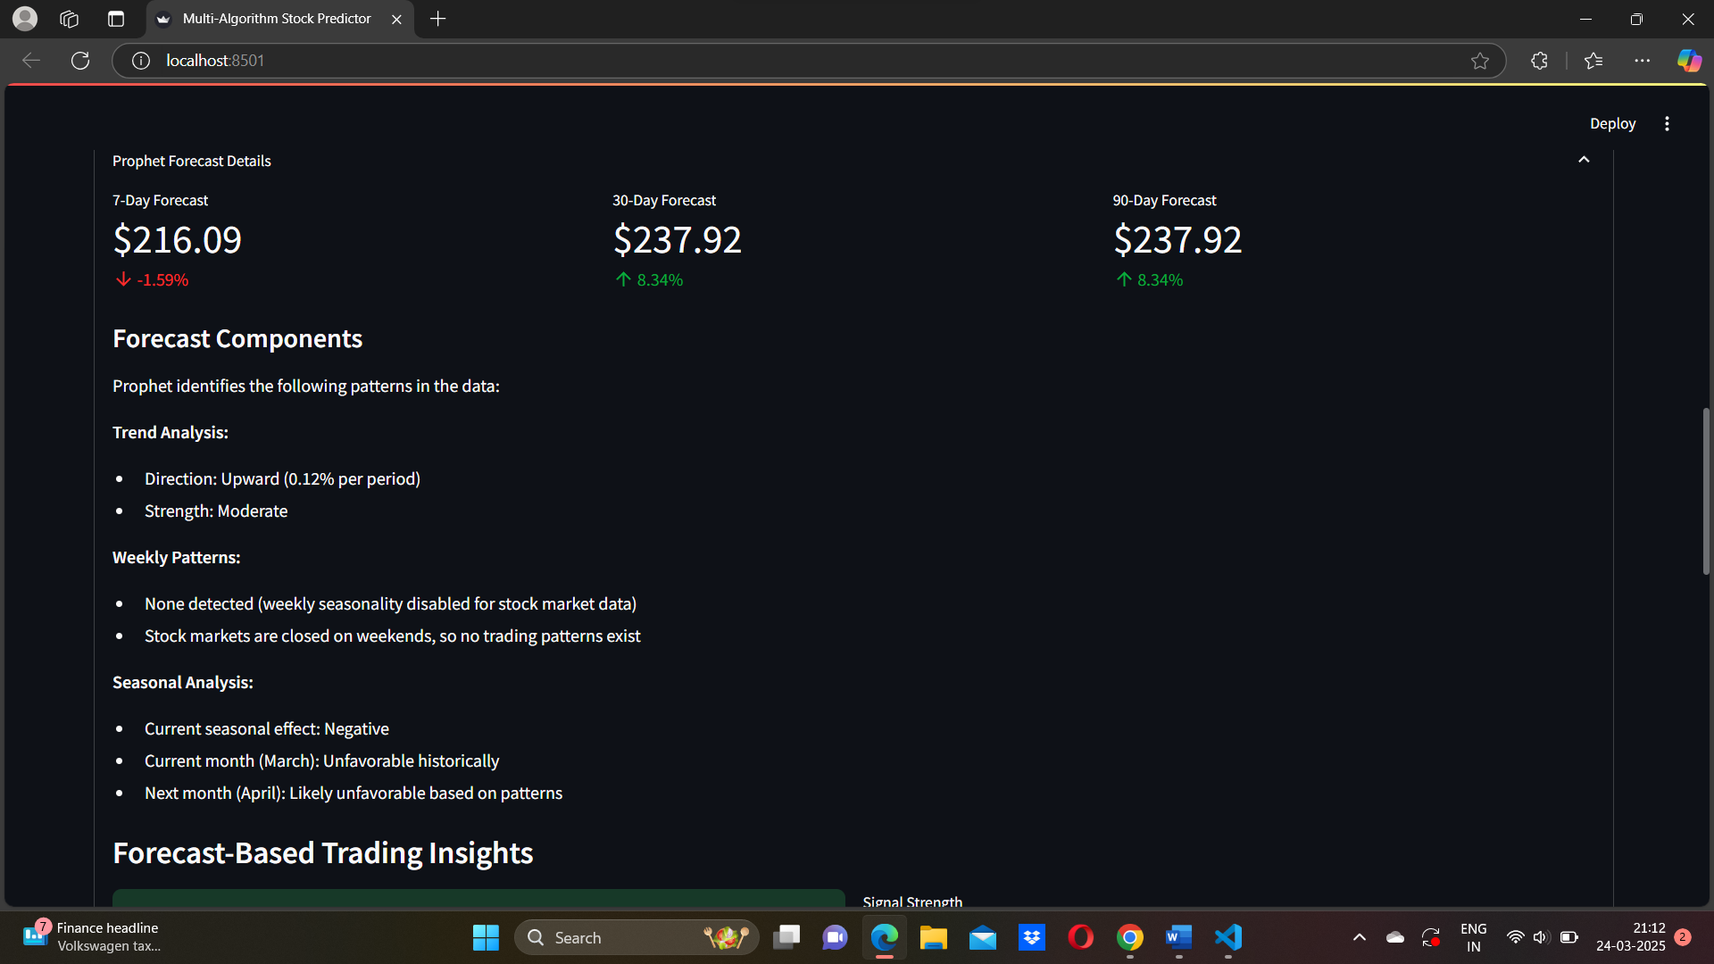
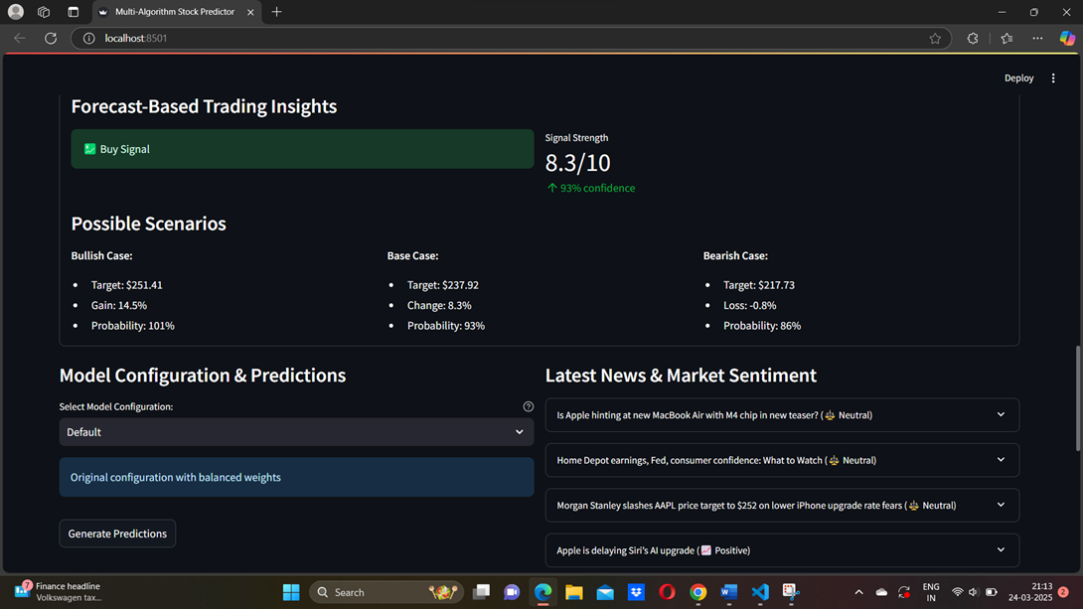

Slide 38
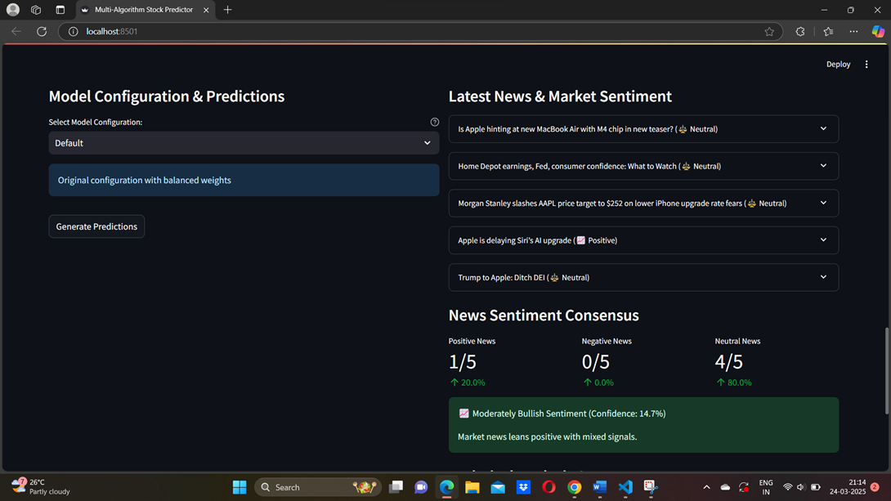
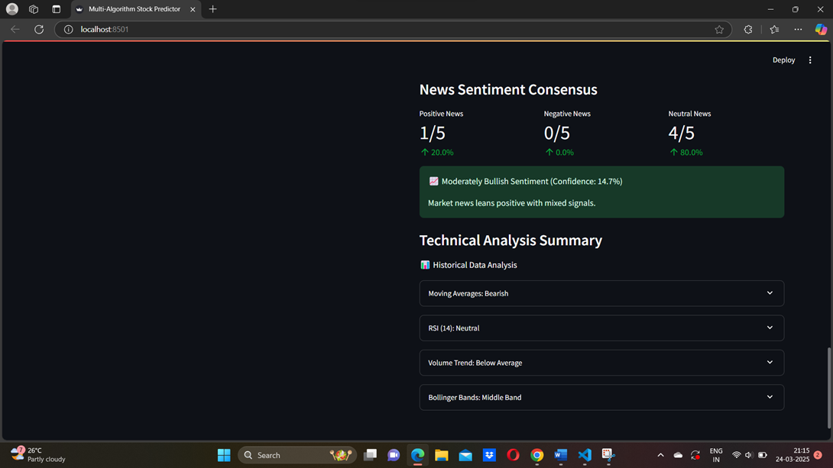

Slide 39

Limitations & Challenges
🚫 Limitations:
Cannot predict unexpected market crashes. (black swan events)
Less accurate in high volatility markets.
Requires quality historical data for better results.
🔄 Challenges:
Data quality & real-time API limitations.
Handling noise in financial data.
Improving model accuracy in extreme market conditions.

Slide 40

Future Improvements Add social media sentiment analysis. (Twitter, Reddit) Improve deep learning models for better accuracy. Introduce real-time market correlation analysis. Portfolio optimization & risk-adjusted returns.
This Photo by Unknown Author is licensed under CC BY-NC-ND

Slide 41

Business Use Cases
Retail Investors
Financial Analysts
Institutions
Stock Brokers

Slide 42

Conclusion
In conclusion, predicting stock market movements involves a thorough understanding of historical trends, various prediction models, and multiple influencing factors. By assessing risks and recognizing future trends, investors can make more informed decisions.

Slide 43

THANKYOU

Slide 44

ANY QUESTIONS

